Slide 1

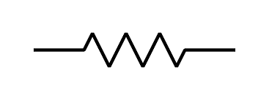


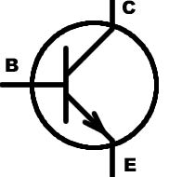
Schematic
3.3V
Regulator
Trigger Board
IN
OUT
Battery+
GND
470uF
CUT
TRACE
+5V USB Input
10Ω
V+ Out
5V
Relay
Trigger
USB Ground
10Ω
Battery Ground
USB Data
5V Boost
Regulator
IN
OUT
GND
100uF
1kΩ
1kΩ
Arduino Micro
(or Leonardo, or ATmega32u4)
5v
D7
(USB Pwr Detect)
D2
(Trigger)
NPN
470uF
GND
USB DATA
(Pwr Off)
A11
D12
(Pwr On)
D3
(LCD Data)
A0 - A10
Radar Gun Control Board
R1
Trace
LCD Pins

Slide 2
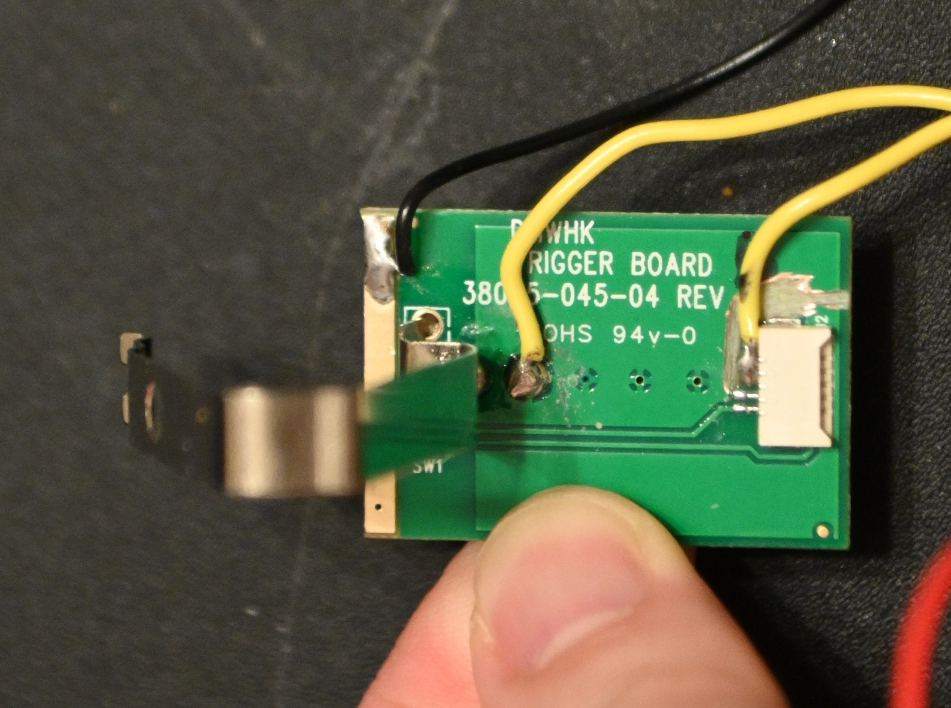
Trigger Board “Rev B” Modification Diagram
Trigger
Control
L-shaped
Cut Trace
separate
Battery +
from
board V+
Board
Positive
Top 3 Pins
all tied
together
Battery
Positive
L-shaped
Cut Trace
separate
Battery +
from
board V+
Do Not Cut
bottom 2
traces

Slide 3
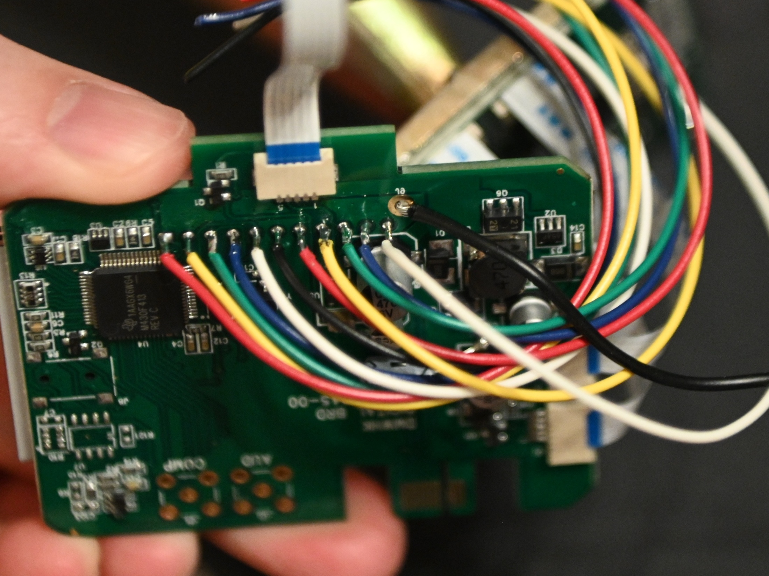
Main Board Modification Wiring
--A10
--A9
--A8
--A7
--A6
--A5
--A4
--A3
--A2
--A1
--A0
PWR
OFF
PWR
ON

Slide 4
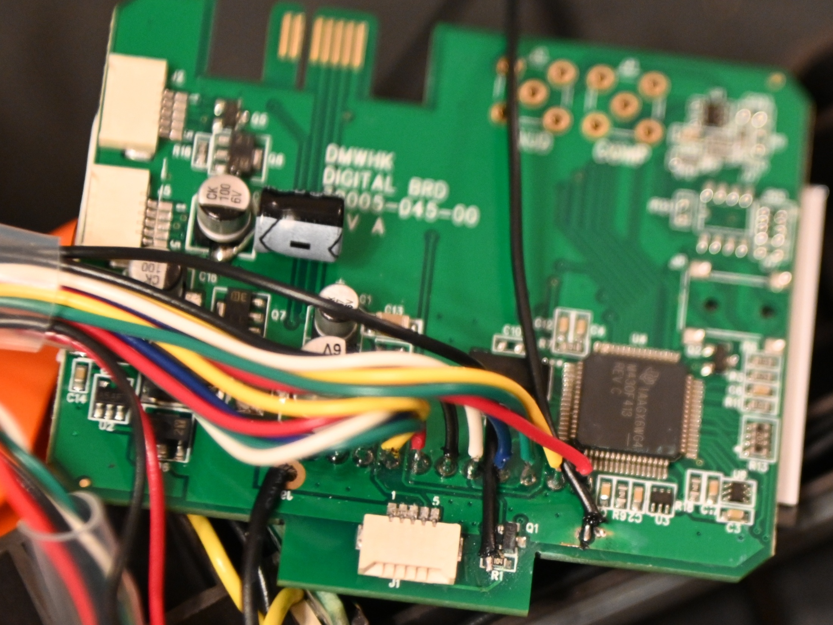
Main Board Modification Wiring
--A10
--A9
--A8
--A7
--A6
--A5
--A4
--A3
--A2
--A1
--A0
PWR
OFF
PWR ON

Slide 5
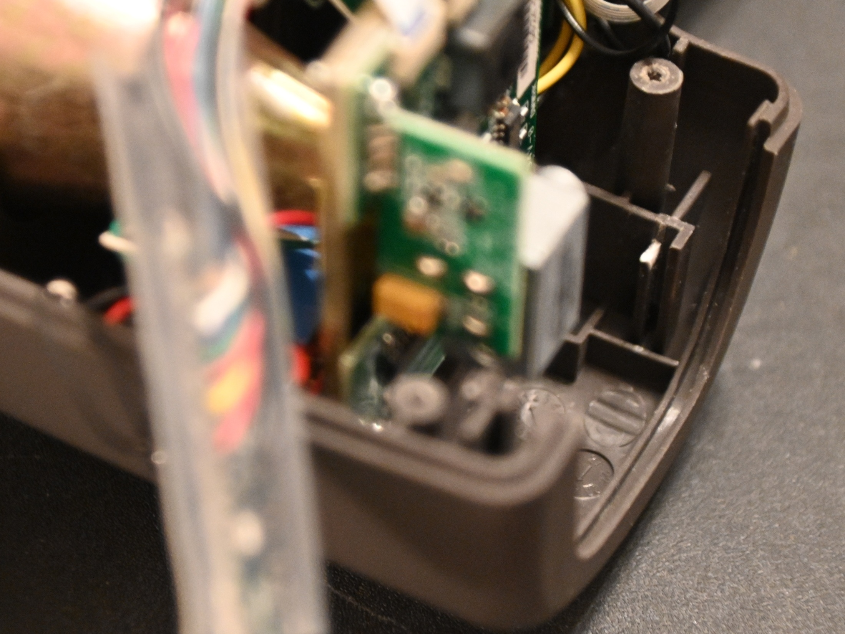
Case Modification
Cut/Remove
rear guide
1/4 to 3/8 inch
This portion of the
guide will damage
the trace for the
power-off wire
when board installed

